Slide 1
World Refugee Forecast
Progress Report
Nathaniel Arnold | Ashley Overman |
Rishi Khanna | Basheer Eljabaly

Slide 2
Progress and Strategy Summary
Divide and Conquer
Each team member focused on a subset of the data for cleaning and processing.
The data subsets were then independently analyzed using various plotting techniques.
Data sets considered:
Refugee Populations by Country of Origin (World Bank)
Refugee Populations by Country of asylum (World Bank)
Food Deficit in Kilocalories (World Bank)
GDP Per Capita (World Bank)
Imports and Exports by Country (World Bank)
Asylum Seekers
Happiness Index
Notes:
Feel Free to edit this and add in your data set(s) and techniques, I just thought an intro slide would be a good addition.

Slide 3
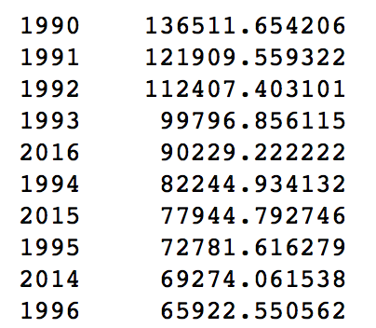
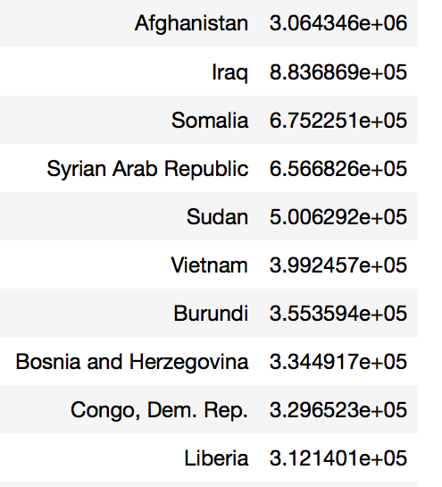
Average Refugee Population (1990-2016)
Top 10 By Year
Top 10 By Country
Notes:
Note about Scientific Notation: 3e+06 = 3 million, 8e+05 = 8 hundred thousand.

Slide 4
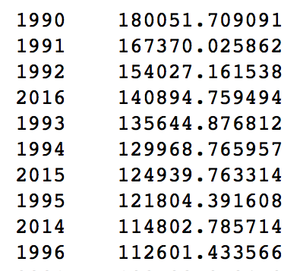
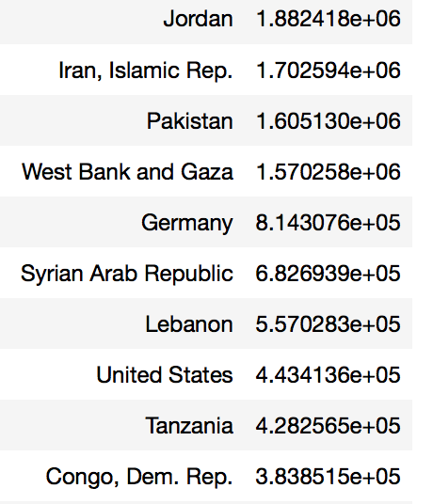
Average Asylum Seekers Population (1990-2016)
Top 10 By Year
Top 10 By Country
Notes:
Note: the average amount of asylum seekers goes up by year as compared to the average amount of refugees in the previous slide
It is also interesting that the Countries that are reporting the highest number of asylum seekers happen to border those Countries with the highest refugee populations. This trend is actual fairly intuitive, but the perception in western countries tends to be that most refugees seek asylum in Europe of the US, which is simply not true even as Germany comes in at number 5 (814,000) and the U.S. at number 8 (443,000).

Slide 5
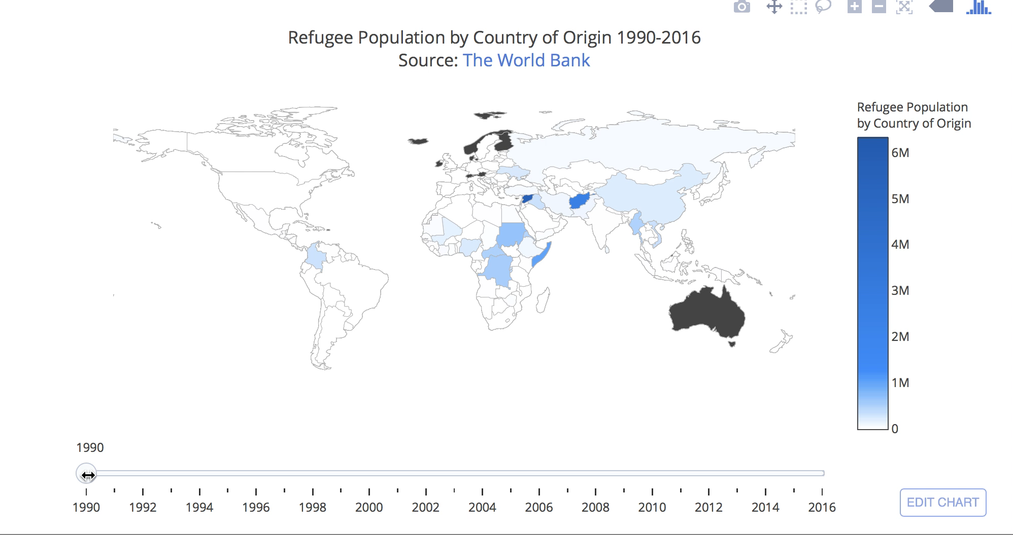
Notes:
This is a video of the world refugee population by country of origin from 1990 to 2016 as represented in a choropleth with a dynamic slide bar animation.
Note: Speed up the video to 2x
The black areas are countries that we don’t have any data from

Slide 6
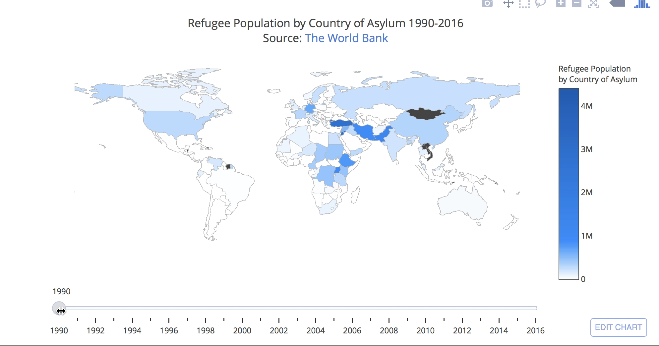
Notes:
This is a video of the world refugee population by country of asylum from 1990 to 2016 as represented in a choropleth with a dynamic slide bar animation.
Note: Speed up the video to 2x
The black areas are countries that we don’t have any data for

Slide 7
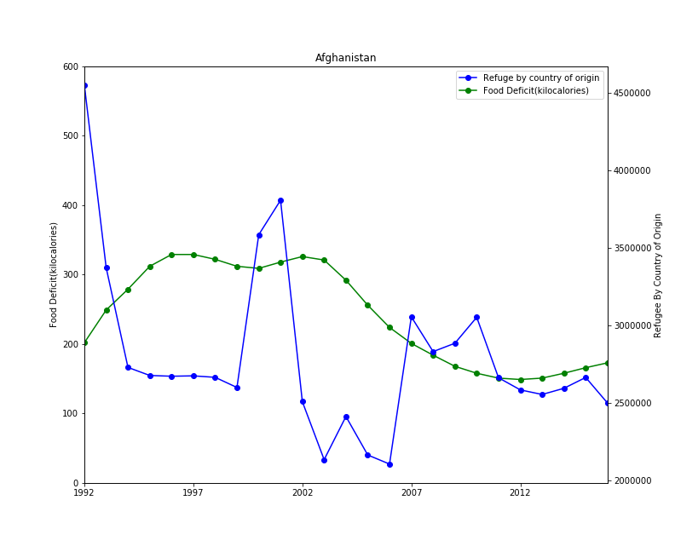
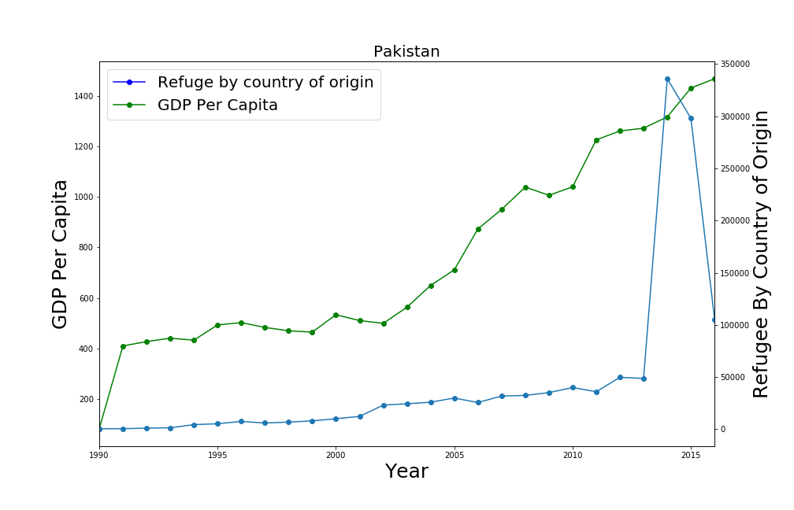
Notes:
Advantage: Able to see all years of one country at once
Disadvantage: you only see two factors and it would take forever to compare them all by typing in each country as input

Slide 8
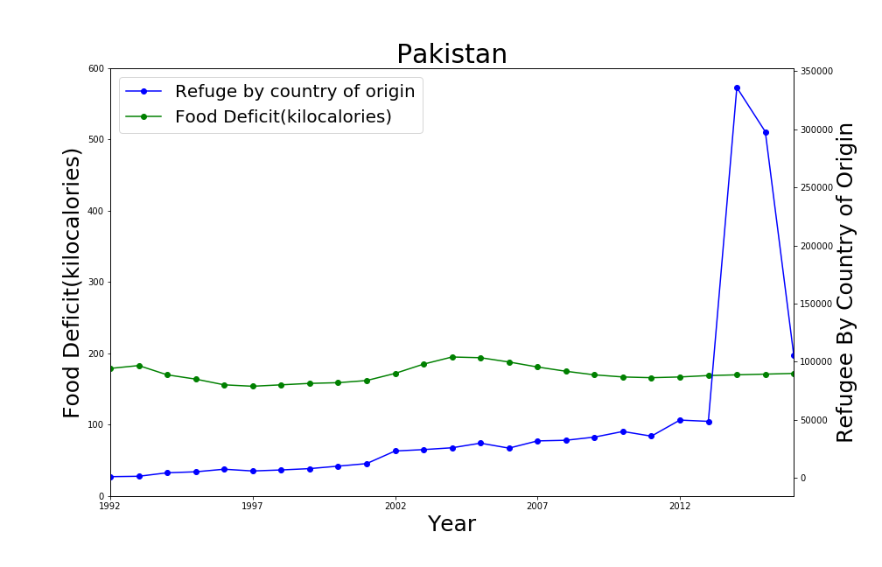

Slide 9
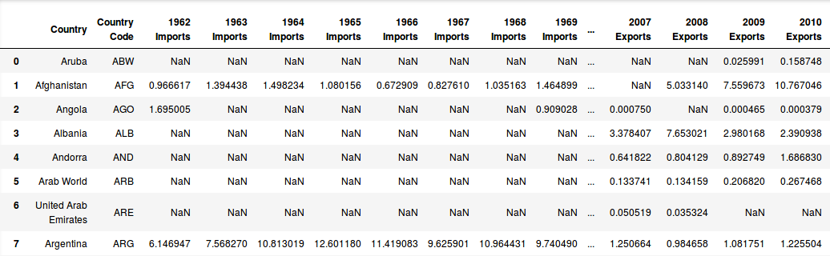
Imports and Exports
Allow users to choose one, two or three years of imports and/or export data to view
Displayed by bar charts
Easy to compare this way
Can be correlated with GDP in the future
Data set ranges from 1962-2016

Slide 10
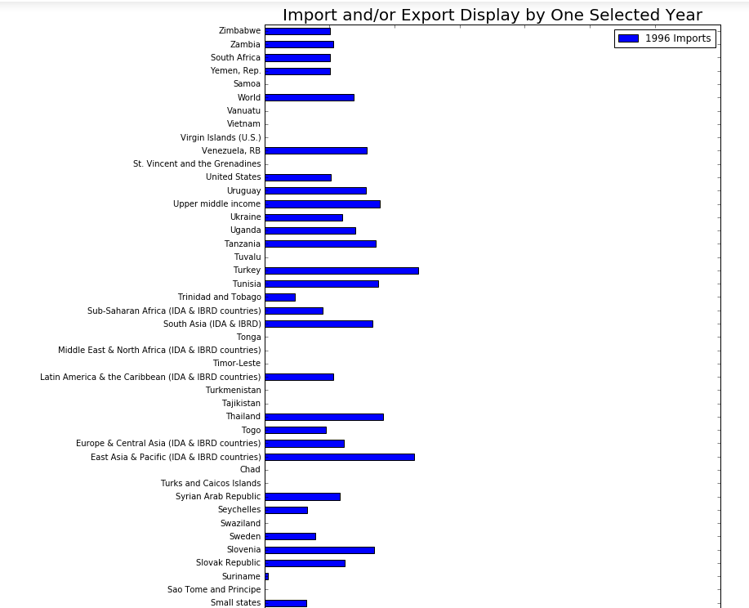

Slide 11
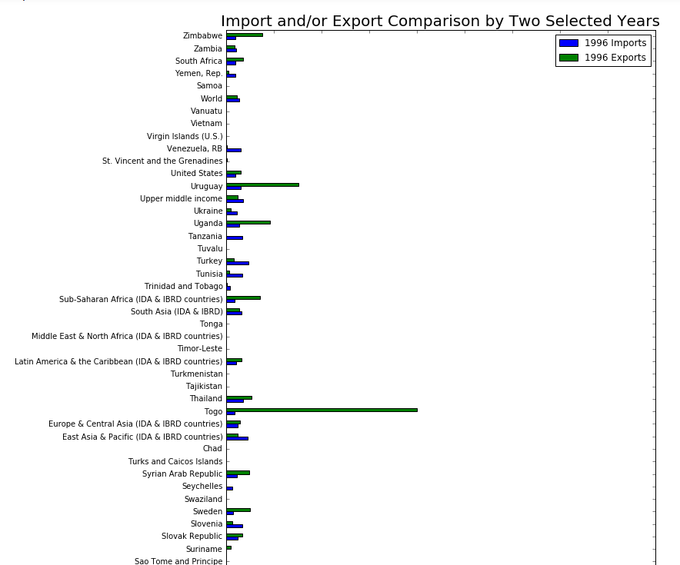

Slide 12
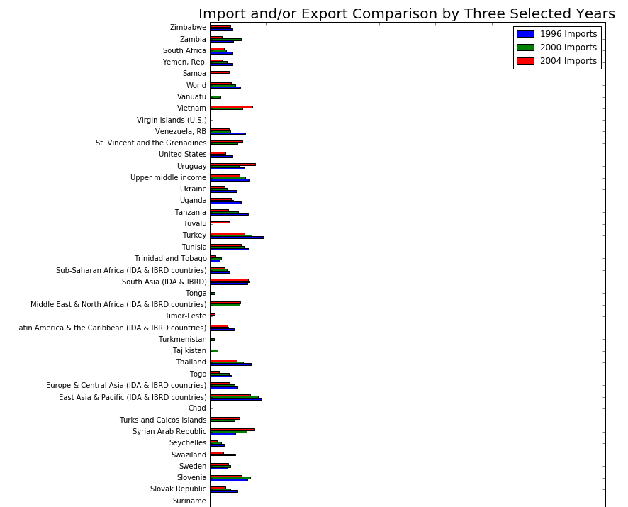

Slide 13
Happiness Index
Using the data set for asylum seekers to connect with countries that most people are going to and see their Happiness Index from the Happiness Index Dataset.
This will provide us with an indication as to whether or not they are moving to a place with a bigger Happiness Index or somewhere else for another reason.
May have to use another data set instead of asylum seekers.

Slide 14
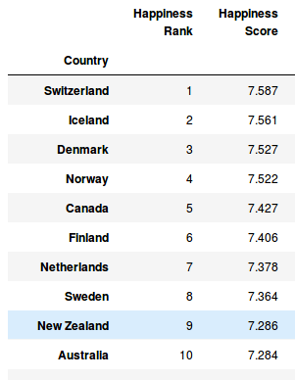
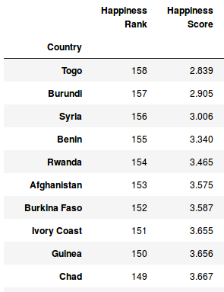
Happiness Index Highest and Lowest Countries for 2015
Highest Countries
Lowest Countries

Slide 15
Priorities(and what we can realistically finish)
Observe correlations between number of refugees, agricultural yields (including GDP), happiness index, and food deficits to predict whether or not individuals are leaving countries due to famine or failure to produce crops to sustain the population.
If these factors are somehow correlated then how strong is their effect on refugee population
Forecast where a large influx of refugees are likely to move to in the future.
Tracking valid migration based on passport authorization
Notes:
(Feel free to change the priorities or add more. I changed refugee patterns because I was not sure if the meaning would be intuitive for the audience)
From 1 being the highest priority to the last number being the lowest priority. We want to get everything on this list done, but we might not have the time or the technical know how. The higher it is on the list, the more likely it is to be done.

